Slide 1
Chapter 3: The Enhanced E-R Model
Modern Database Management

Slide 2
Objectives
Define terms
Understand use of supertype/subtype relationships
Understand use of specialization and generalization techniques
Specify completeness and disjointness constraints
Develop supertype/subtype hierarchies for realistic business situations
Develop entity clusters
Explain universal (packaged) data model
Describe special features of data modeling project using packaged data model

Slide 3
Supertypes and Subtypes
Enhanced ER model: extends original ER model with new modeling constructs
Subtype: A subgrouping of the entities in an entity type that has attributes distinct from those in other subgroupings
Supertype: A generic entity type that has a relationship with one or more subtypes
Attribute Inheritance:
Subtype entities inherit values of all attributes of the supertype
An instance of a subtype is also an instance of the supertype

Slide 4
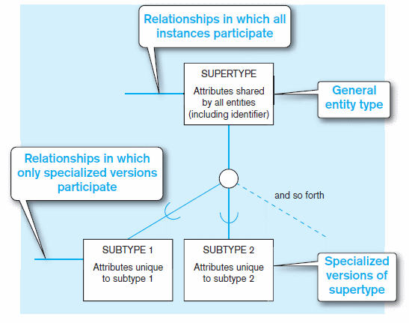
Figure 3-1 Basic notation for supertype/subtype notation
a) EER notation
4

Slide 5
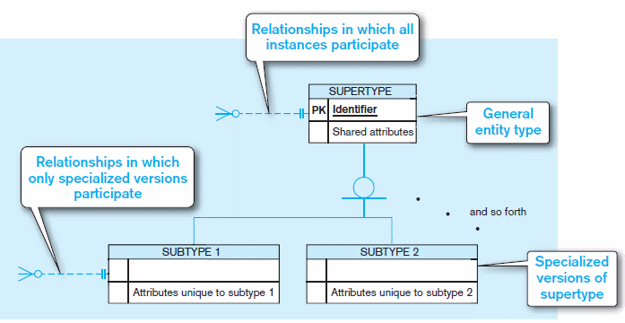
Figure 3-1 Basic notation for supertype/subtype notation (cont.)
b) Microsoft Visio Notation
Different modeling tools may have different notation for the same modeling constructs.
5

Slide 6
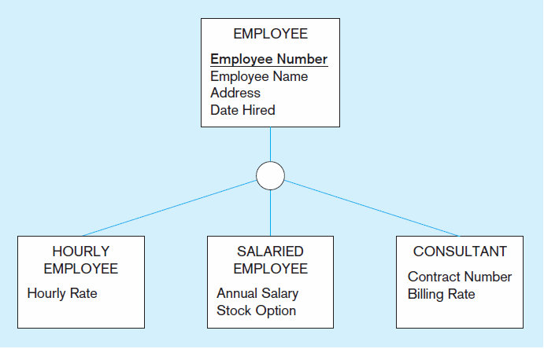
Figure 3-2 Employee supertype with three subtypes
All employee subtypes will have employee number, name, address, and date hired
Each employee subtype will also have its own attributes
6

Slide 7
Relationships and Subtypes
Relationships at the supertype level indicate that all subtypes will participate in the relationship
The instances of a subtype may participate in a relationship unique to that subtype. In this situation, the relationship is shown at the subtype level

Slide 8
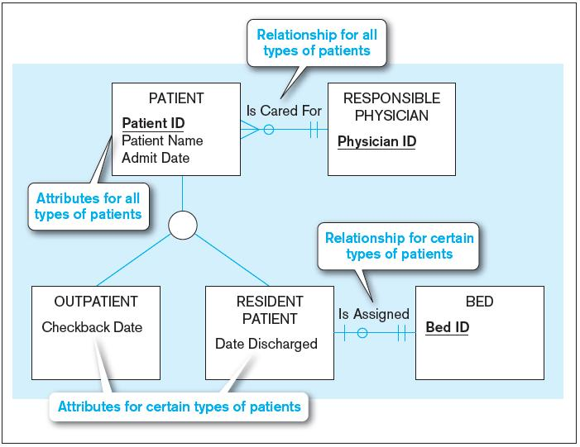
Figure 3-3 Supertype/subtype relationships in a hospital
8

Slide 9
Generalization and Specialization
Generalization: The process of defining a more general entity type from a set of more specialized entity types. BOTTOM-UP
Specialization: The process of defining one or more subtypes of the supertype and forming supertype/subtype relationships. TOP-DOWN

Slide 10
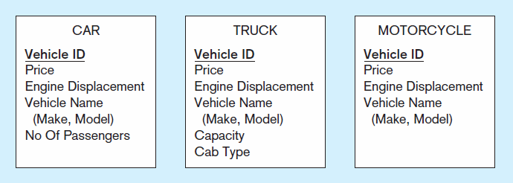
Figure 3-4 Example of generalization
a) Three entity types: CAR, TRUCK, and MOTORCYCLE
All these types of vehicles have common attributes
10

Slide 11
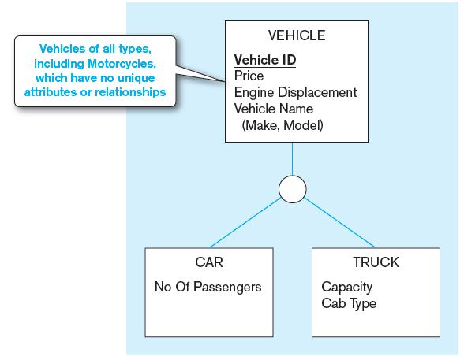
Figure 3-4 Example of generalization (cont.)
b) Generalization to VEHICLE supertype
So we put the shared attributes in a supertype
Note: no subtype for motorcycle, since it has no unique attributes
11

Slide 12
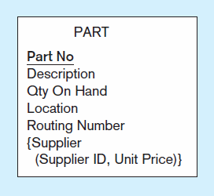
Figure 3-5 Example of specialization
a) Entity type PART
Only applies to manufactured parts
Applies only to purchased parts
12

Slide 13
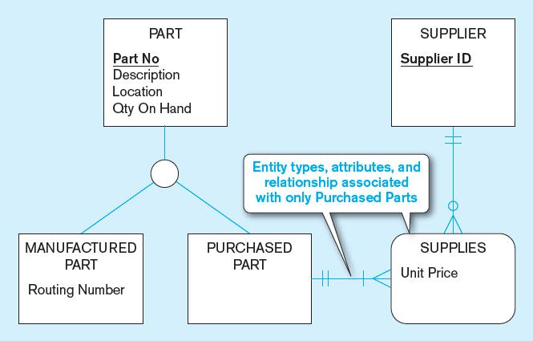
Figure 3-5 Example of specialization (cont.)
b) Specialization to MANUFACTURED PART and PURCHASED PART
Created 2 subtypes
Note: multivalued composite attribute was replaced by an associative entity relationship to another entity
13

Slide 14
Constraints in Supertype/SUBTYPE RELATIONSHIPS
Completeness Constraints: Whether an instance of a supertype must also be a member of at least one subtype
Total Specialization Rule: Yes (double line)
Partial Specialization Rule: No (single line)

Slide 15
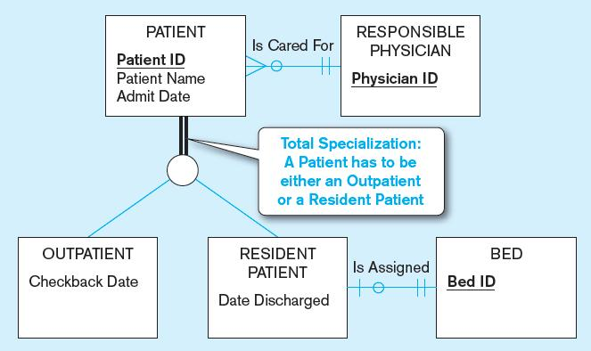
Figure 3-6 Examples of completeness constraints
a) Total specialization rule
15

Slide 16
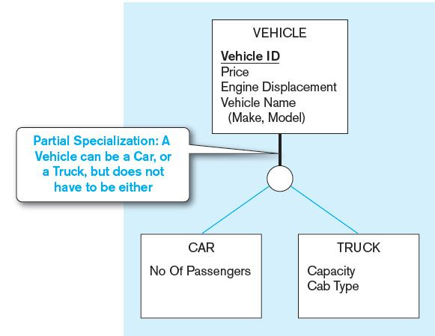
Figure 3-6 Examples of completeness constraints (cont.)
b) Partial specialization rule
16

Slide 17
Constraints in Supertype/SUBTYPE RELATIONSHIPS
Disjointness Constraints: Whether an instance of a supertype may simultaneously be a member of two (or more) subtypes
Disjoint Rule: An instance of the supertype can be only ONE of the subtypes
Overlap Rule: An instance of the supertype could be more than one of the subtypes
17

Slide 18
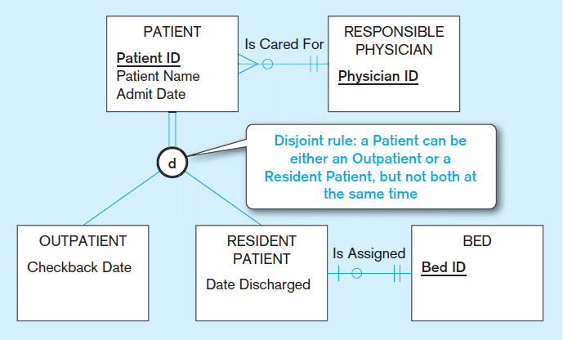
Figure 3-7 Examples of disjointness constraints
a) Disjoint rule
18

Slide 19
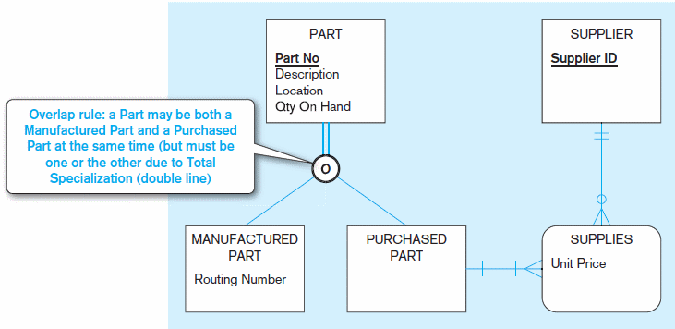
Figure 3-7 Examples of disjointness constraints (cont.)
b) Overlap rule
19

Slide 20
Constraints in Supertype/SUBTYPE RELATIONSHIPS
Subtype Discriminator: An attribute of the supertype whose values determine the target subtype(s)
Disjoint – a simple attribute with alternative values to indicate the possible subtypes
Overlapping – a composite attribute whose subparts pertain to different subtypes. Each subpart contains a Boolean value to indicate whether or not the instance belongs to the associated subtype
20

Slide 21
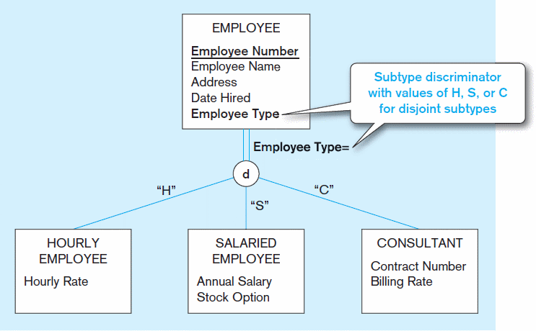
Figure 3-8 Introducing a subtype discriminator (disjoint rule)
21

Slide 22
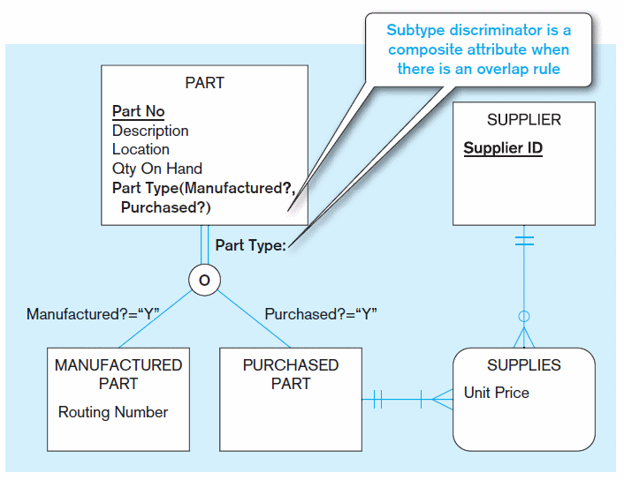
Figure 3-9 Subtype discriminator (overlap rule)
22

Slide 23
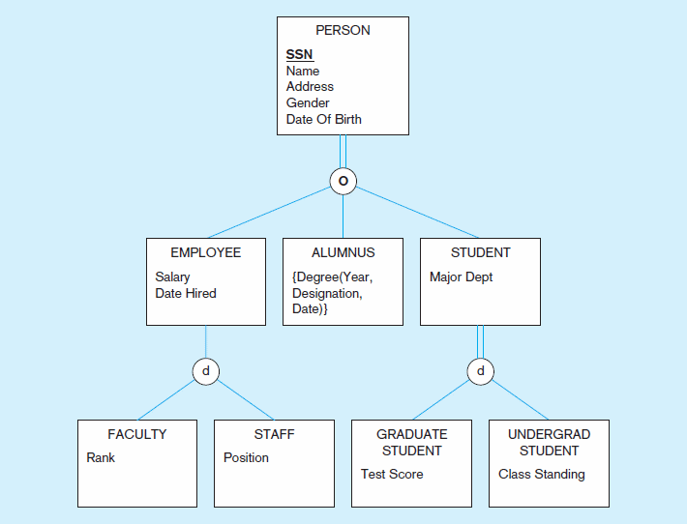
Figure 3-10 Example of supertype/subtype hierarchy
23

Slide 24
Entity Clusters
EER diagrams are difficult to read when there are too many entities and relationships.
Solution: Group entities and relationships into entity clusters.
Entity cluster: Set of one or more entity types and associated relationships grouped into a single abstract entity type

Slide 25
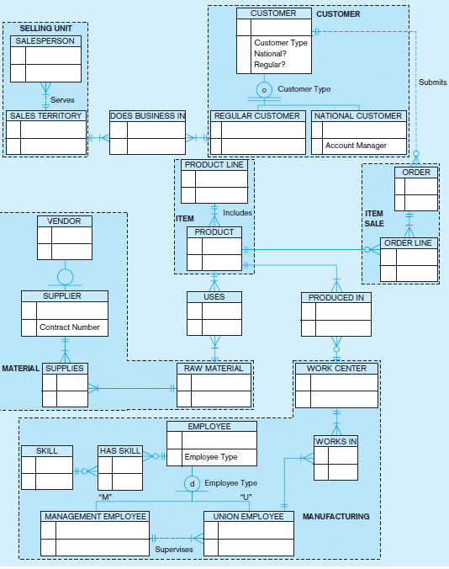
Figure 3-13a Possible entity clusters for Pine Valley Furniture in Microsoft Visio
Related groups of entities could become clusters

Slide 26
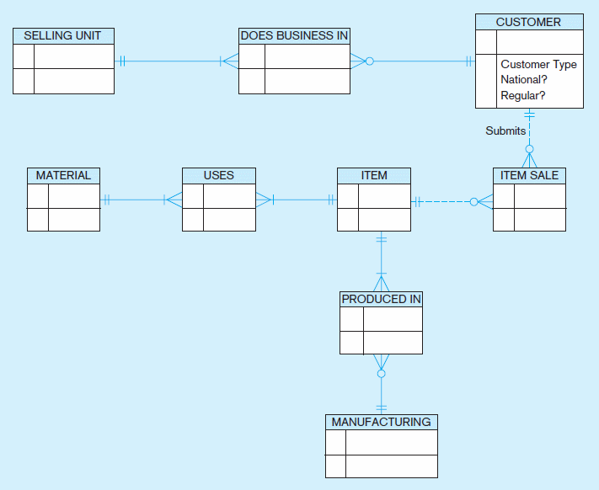
Figure 3-13b EER diagram of PVF entity clusters
More readable, isn’t it?
26

Slide 27
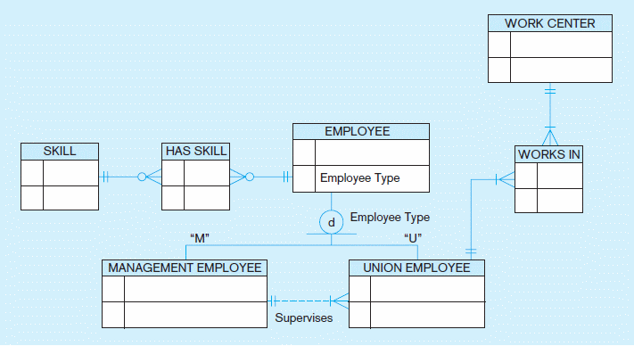
Figure 3-14 Manufacturing entity cluster
Detail for a single cluster
27

Slide 28
Packaged Data Models
Predefined data models
Could be universal or industry-specific
Universal data model = a generic or template data model that can be reused as a starting point for a data modeling project (also called a “pattern”)

Slide 29
Advantages of Packaged Data Models
Use proven model components
Save time and cost
Less likelihood of data model errors
Easier to evolve and modify over time
Aid in requirements determination
Easier to read
Supertype/subtype hierarchies promote reuse
Many-to-many relationships enhance model flexibility
Vendor-supplied data model fosters integration with vendor’s applications
Universal models support inter-organizational systems

Slide 30
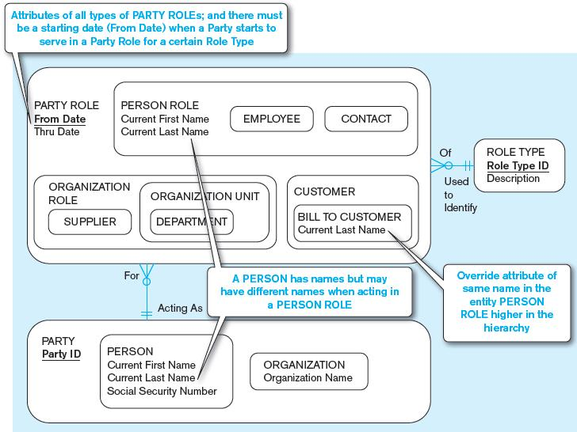
Figure 3-15 PARTY, PARTY ROLE, and ROLE TYPE in a universal data model
(a) Basic PARTY universal data model
Packaged data models are generic models that can be customized for a particular organization’s business rules.
30

Slide 31
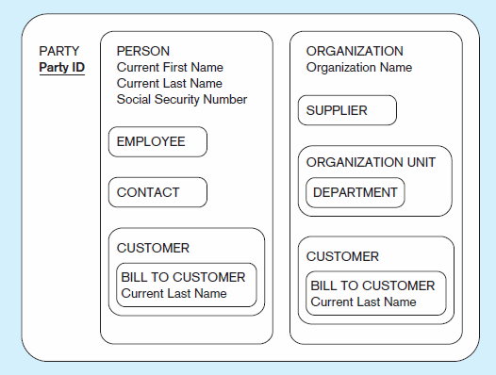
Figure 3-15 PARTY, PARTY ROLE, and ROLE TYPE in a universal data model
(b) PARTY supertype/subtype hierarchy
31

